Slide 1
School board trustees: roles and responsibilities
Local Government Week
October 21 to 26, 2019
#LocalGovWeek

Slide 2
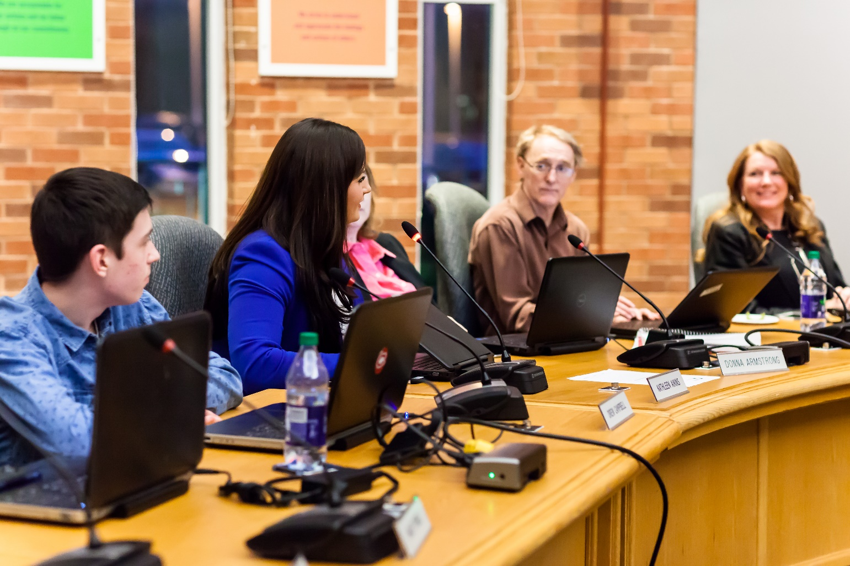
What do you think school board trustees do?

Slide 3

Education – It’s in our hands.
For a video that explains the role of school board trustees click: https://www.youtube.com/watch?v=ouTh31p1JuY
This video was used to promote 2014’s Municipal and School Board Elections. Visit www.elections.ontarioschooltrustees.org to learn more about trustees and the municipal election process.

Slide 4
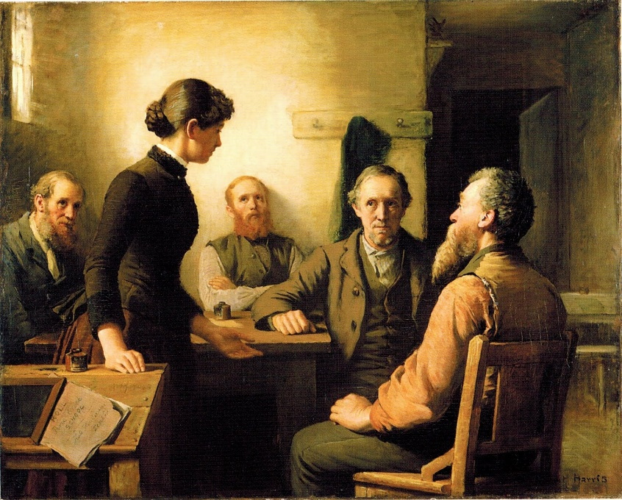
What is a school board trustee?
School board trustees are the oldest form of elected representation in Ontario.
The office has been in existence since 1807 and represents citizens in the education decision-making process.
The election of school board trustees
is governed by the Education Act and the Municipal Elections Act, 1996. Both are the laws or rules that trustees follow.
A Meeting of the School Trustees – Robert Harris,1885

Slide 5

Types of Trustees
Trustees are elected every four years during municipal and school board elections. There are 317 publicly elected trustees representing the 31 public English school boards across Ontario.
Indigenous Trustees are appointed to the board by their First Nation. There are 15 appointed trustees among the 31 public English district school boards across Ontario.
Student Trustees elected by the student body of the district school board. The Ontario Student Trustees' Association represents more than 2,000,000 students.
The next Municipal and School Board Election
will be held on
October 24, 2022.

Slide 6

The role of the Trustee
School trustees are of the community, by the community and for the community.
They are members of the district school board and are locally-elected representatives of the public.
They are the community’s advocates for public education.

Slide 7

Additional trustee responsibilities:
Maintain focus on student achievement and well-being.
Consult with parents, students and supporters of the district on its multi-year plan.
Bring concerns of parents, students and supporters of the board to the attention of the district school board.
Attend and participate in meetings of the board, including committee meetings.

Slide 8

Why are trustees important?
School boards trustees are locally and democratically elected.
School board trustees are the only publicly elected official with the direct responsibility for the education of our children.
School board trustees are communicators, problem solvers and most importantly, advocates for public education.

Slide 9
Well-known school board trustees
Current Members of Provincial Parliament (MPP) who were public school trustees include: Former Premier Kathleen Wynne, Billy Pang, Catherine Fife, Chris Glover, Marit Stiles, Lisa Gretzky, Peggy Sattler, and Michael Coteau.
Many MPs, Mayors and Municipal Councillors were also public school board trustees.

Slide 10
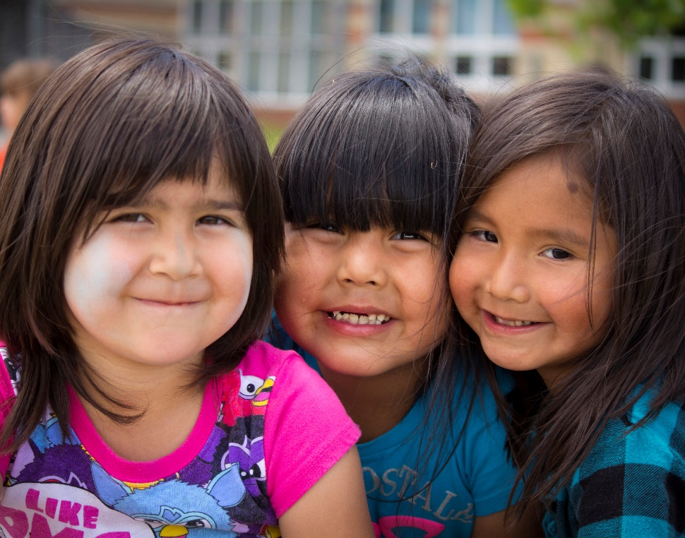
School Board Responsibilities
School Boards are responsible for student achievement and well-being, for ensuring effective stewardship of the board’s resources and for delivering effective and appropriate education programs for their students.

Slide 11

School Board Responsibilities
Collectively, the board of trustees:
sets the vision for the school board
develops policies, allocates resources, and sets the goals that drive programs and operations in the board.
creates the district’s multi-year strategic plan for student achievement and well-being.
recruits and monitors the performance of the Director of Education.

Slide 12
X District School Board
CUSTOMIZE THIS SLIDE FOR YOUR LOCAL BOARD
Suggested content includes:
Local board facts and figures
Board logo
Photo of the Director of Education
Photo/list of board of trustees
Where is the head office? What departments are located there?

Slide 13
X District School Board cont.d
CUSTOMIZE THIS SLIDE FOR YOUR LOCAL BOARD
Suggested content includes:
List your board’s current priorities and main initiatives
Add your board advisory committees here, including PIC, SEAC, Indigenous Education, etc.

Slide 14
X District School Board cont.d
CUSTOMIZE THIS SLIDE FOR YOUR LOCAL BOARD
Suggested content includes:
Highlighting a key program, photos, videos

Slide 15
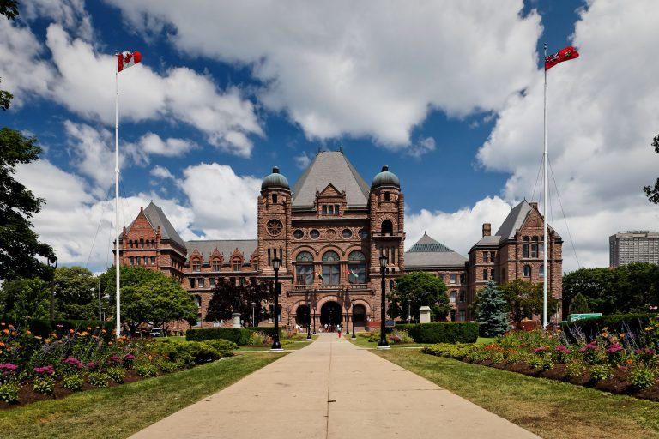
The Ontario Public School Boards’ Association
Our board is a member of OPSBA, which represents 31 public district school boards and 10 public school authorities across Ontario.
OPSBA’s members serve the educational needs of nearly 70% of Ontario’s elementary and secondary students. The Association, based in Toronto, advocates to the provincial government on behalf of the best interests and needs of the public school system in Ontario.
OPSBA believes that the role of public education is to provide universally accessible education opportunities for all students regardless of their ethnic, racial or cultural backgrounds, social or economic status, individual exceptionality, or religious affiliation.

Slide 16
Who are the people in a school board?
Students (YOU!)
Parents and Caregivers
Trustees
Teachers
Education Workers
Principals
Supervisory Officers
Director of Education

Slide 17
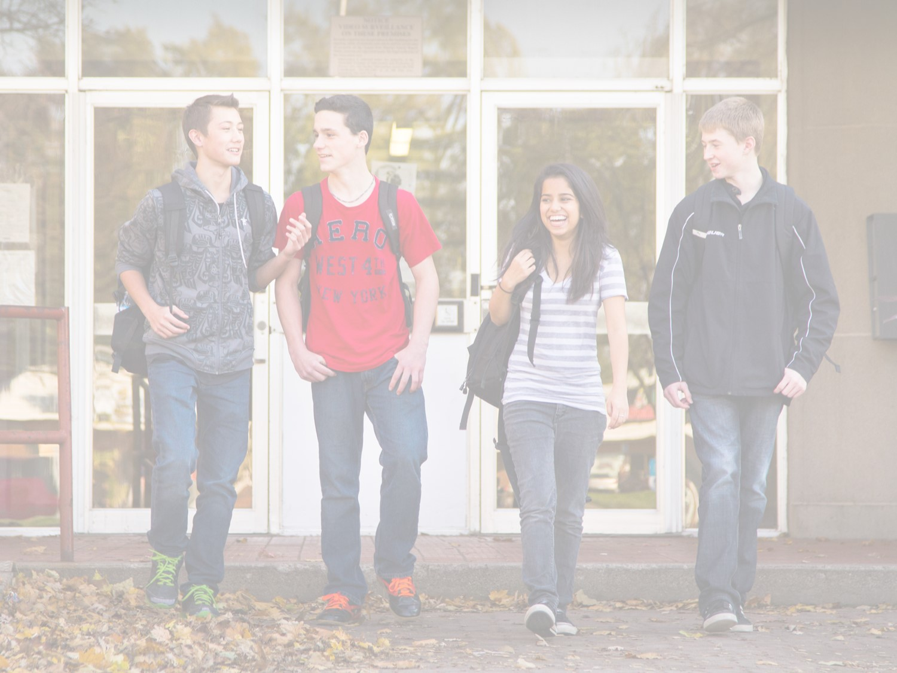
What makes for a strong education system?
A system that prepares students to become productive and contributing citizens is the foundation of a civil society.
Ontario’s English public school boards provide universally accessible education for all students, regardless of their ethnic, racial, or cultural backgrounds; social or economic status; gender; individual exceptionality; or religious preference.
Character education embraces values such as citizenship, cooperation, courage, empathy, fairness, honesty, humility, inclusiveness, initiative, integrity, kindness, optimism, perseverance, resilience, respect, and responsibility.

Slide 18
What are the “rules” for school?
Children and youth between the ages of six and 18 must be enrolled in a formal education program.
An Ontario Secondary School Diploma (OSSD) requires students to complete 30 credits, complete the Ontario Secondary School Literacy Test and fulfill 40 hours of community involvement activities.
Students who leave school before earning the OSSD may be granted the Ontario Secondary School Certificate.

Slide 19
Where does the funding come from?
The Kindergarten-Grade 12 education sector is the second-largest recipient of provincial funding, after healthcare. The Ontario provincial government spends more than $24.6 billion on education each year. The money comes from taxpayers across the province.
Ontario’s public school trustees oversee budgets ranging from about $42 million to approximately $3.4 billion.

Slide 20
Why do you think people run for public office?

Slide 21
Why is it important to vote in elections?

Slide 22

What do you think my office looks like?

Slide 23
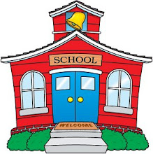
Why are school boards important?

Slide 24
Any questions?
Insert your contact information here
Photo, Email, Social Media

